Slide 1
Sprint Demo 3
Industry project - grow box

Slide 2
What we promised
Set up ESP32 to MQTT broker server
Finish communication protocol
Connect a Fan / PH sensor
Control one Grow-Box with node-red
  Ex: Turn on / Turn off led with node-red dashboard
  Visualize data with dashboard
  Control fan speed

Slide 3
Change of plan and reason
Communication method changed
  ESP-Now -> UDP connection
No extra/external server needed (Laptop running mosquito)
local and worldwide communication
MQTT will still be used for dashboard

Slide 4
What we achieved
Communication between ESPs using UDP
  Register grow boxes once they connect to the server
  Send any type of data
Finished communication protocol rough draft
  May still need to be modified
Connect a Fan / PH sensor
Node-red dashboard

Slide 5
Retrospective
Changed the way of communicating ( Esp -> Esp)
  We had esp-now, changed it for UDP
  Wifi and esp-now were not working at the same time

Slide 6
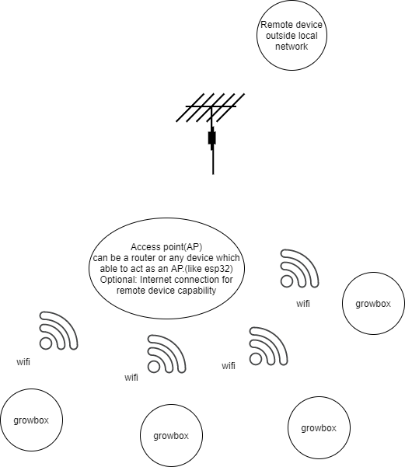
Communication
System Architecture
We have an ESP that will be serving as an access point for all other ESPs to communicate with each other.
The Esp will be programed in a way that it will be plug and play.

Slide 7
Demo

Slide 8
Sprint Demo 4
Connect the ESP to the Simulation
Connect Node-Red Server
Go over communication protocol
  Check for any changes after implementing
Implement the rest of the communication protocol

Slide 9
Thank you!
Questions?

